Slide 1
Software Reverse Engineering
A2 AArch32 and AArch64 Architectures and Assembly Languages
Notes:
This slide deck is part of Software Reverse Engineering.
The context of this slide deck in shown below.
Part 0 – SRE in Context
Part A – SRE Prerequisites
Module A1: x86 and x64 Architectures and Assembly Languages
** Module A2: ARM Architectures and Assembly Languages
Module A3: Forward Engineering
Part B – Philosophical Approaches to SRE
Module B1: Approaches to SRE
Part C – Static Analysis for Binary SRE
Module C1: File Handling Techniques
Module C2: Basic Static Analysis Tools
Module C3: Disassemblers and Decompilers
Part D – Dynamic Analysis for Binary SRE
Module D1: Sandboxing and Other Techniques
Module D2: Basic Dynamic Analysis Tools
Module D3: Debuggers
Module D4: Network Traffic Analysis
Module D5: Patched Binaries
Part E – Obfuscation and Anti-SRE
Module E1: Obfuscation and Anti-SRE
Part E – Non-Binary SRE
Module F1: Non-Binary SRE

Slide 2
Table of Contents
Introduction
Registers
Basic Instructions
Privilege Levels
System Calls
ARM Manuals
Summary
Notes:
These are the topics that are covered in this lesson.

Slide 3
Module A2 – Learning Objectives
Understand the main ARM architectural features that will be relevant to SRE
Registers
Basic instructions
Privilege levels
System calls
Get an introduction to the ARM Manuals
Notes:
These are the learning objectives for Module A1 – x86 and x64 Architectures and Assembly Languages
These learning objectives are assessed through the following methods:
ASKs: There are questions in the note sections for the instructor to involve the students in the lesson and assess their grasp of the concepts.
LABs: There are lab exercises associated with this lesson
QUIZ: There are objective quiz questions associated with this lesson.
ESSAY: There are short answer and essay questions associated with this lesson.

Slide 4
Introduction
(return to table of contents)
Notes:
These are the topics that are covered in this lesson.

Slide 5
Why is this important to SRE?
If you want to know how something works, you can take it apart (carefully).
In order to take a binary apart in a meaningful way, you need to understand the underlying building blocks.
The architecture and assembly languages provide you with a clearer understanding of these basic building blocks and how they work.

Slide 6
Registers
(return to table of contents)
Notes:
These are the topics that are covered in this lesson.

Slide 7
Registers – AArch32
Register | Typical Use
R0 - R3 | Arguments and Return Values (Caller-saved)
R4 - R8 | Local variables (Callee-saved)
R9 - R10 | Usually the Same as r4 - r8, but can be special based on CPU and Mode
R11/FP | Frame Pointer (not always the case based on Mode)
R12 | Scratch Register
R13/SP | Stack Pointer
R14/LR | Link Register
R15/PC | Program Counter (Instruction Pointer)

Slide 8
Registers – AArch64
Register | Typical Use
X0 - X7 and X9 - X15 | Arguments and Return Values (Caller-saved)
X8 | Indirect Return Register
X16 - X18 | Scratch Registers
X19 - X28 | Local variables (Callee-saved)
SP | Stack Pointer
X29 | Frame Pointer (not always the case based on Mode) - NOTE: No FP alias
X30/LR | Link Register
PC | Program Counter

Slide 9
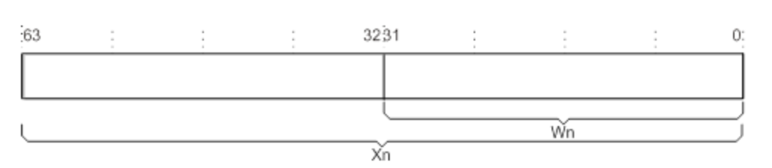
Registers – AArch64 (cont. 1)

Slide 10
Registers – AArch64 (cont. 2)
Register | Typical Use
W0 - W7 and W9 - W15 | Arguments and Return Values (Caller-saved)
W8 | Indirect Return Register
W16 - W18 | Scratch Registers
W19 - W28 | Local variables (Callee-saved)
WSP | Stack Pointer
W29 | Frame Pointer (not always the case based on Mode) - NOTE: No WFP alias
W30 | Link Register (no WLR)
- | Program Counter is only 64-bits.

Slide 11
Special Registers
Register | Typical Use
W31/X31 | Depending on the instruction used, it is either SP or XZR (AArch64 only)
WZR/XZR | Zero Register - Ignores writes and always returns 0 (AArch64 only)
CPSR | Current Program Status Register (flags, 32-bits on AArch32 and 64-bits on AArch64)
FPCR | Floating Point Control Register (floating point settings, 32-bits on AArch32 and 64-bits on AArch64)
Vn | SIMD registers

Slide 12
Basic Instructions
(return to table of contents)
Notes:
These are the topics that are covered in this lesson.

Slide 13
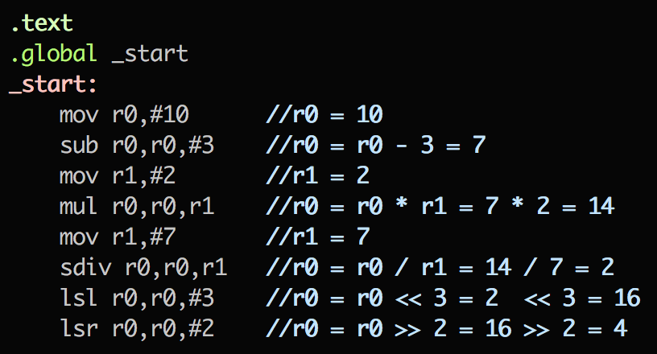
AArch32 Instructions

Slide 14
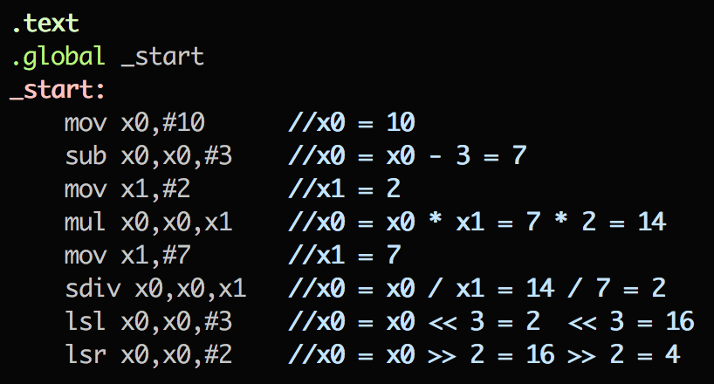
AArch64 Instructions

Slide 15
Privilege Levels
(return to table of contents)
Notes:
These are the topics that are covered in this lesson.

Slide 16
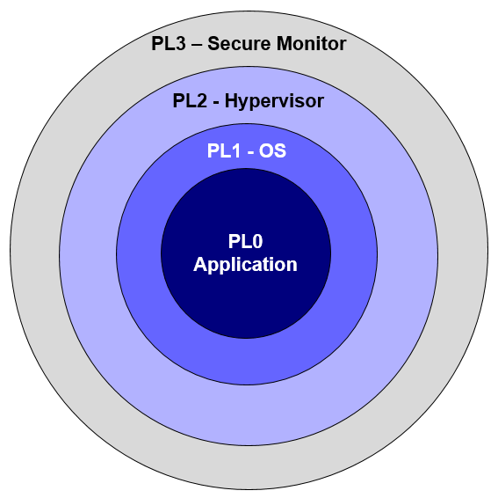
Privilege Levels 1

Slide 17
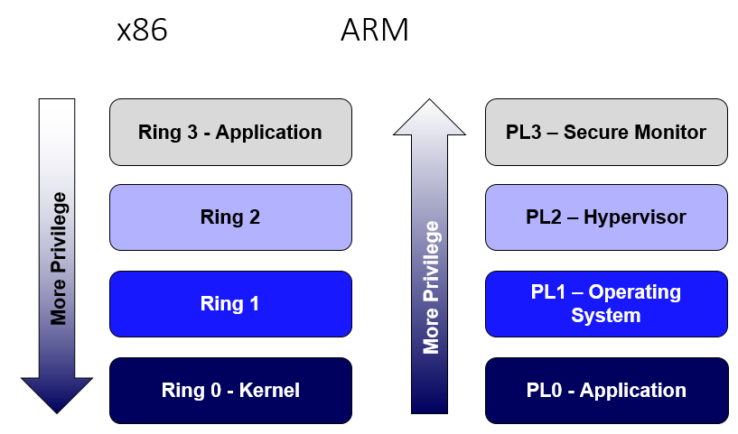
Privilege Levels 2

Slide 18
System Calls
(return to table of contents)
Notes:
These are the topics that are covered in this lesson.

Slide 19
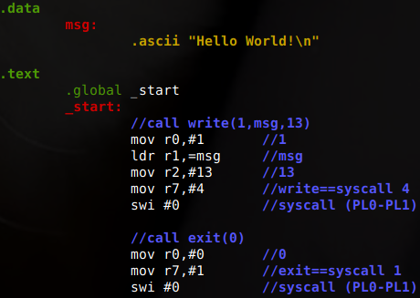
System Calls 1

Slide 20
ARM Manuals
(return to table of contents)
Notes:
These are the topics that are covered in this lesson.

Slide 21
ARM Resources
ARM Cortex-A53 Manual (RPI 2 B+ CPU)
AArch32 Syscall Table
Notes:
ARM has a web-manual interface. It’s searchable, and it’s all in one place for multiple CPUs.
Raspberry Pis make experimentation cheap and easy, so the manual is pointing to that CPU. You can also emulate with QEMU.
Also included a link to the syscall table for said architecture.

Slide 22
Topics
Introduction
Registers
Basic Instructions
Privilege Levels
System Calls
ARM Manuals
Summary
Notes:
These are the topics that are covered in this lesson.

Slide 23
Summary
We covered the main ARM architectural features that will be relevant to SRE
Registers
Basic instructions
Privilege levels
System calls
We previewed the ARM Manuals
Notes:
This section provides a summary of the key points of the lesson and the expected capabilities that students should master before moving on to the next section.

